Slide 1

Report template
Observation
<Observation mentioning numbers, values, and any other relevant information>
Screenshots
of dashboard
showing
total impact
Risk
<Risk relating to inefficiencies/ fraud schemes/ internal control gaps/ fines from local / international oversight bodies>
Recommendation
<Description of the actions that the auditee agrees to implement>
Comments from the auditee
<Comments from the auditee affirming that they agree with the points raised and the action plan to implement>

Slide 2
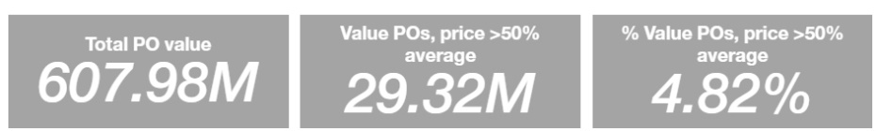
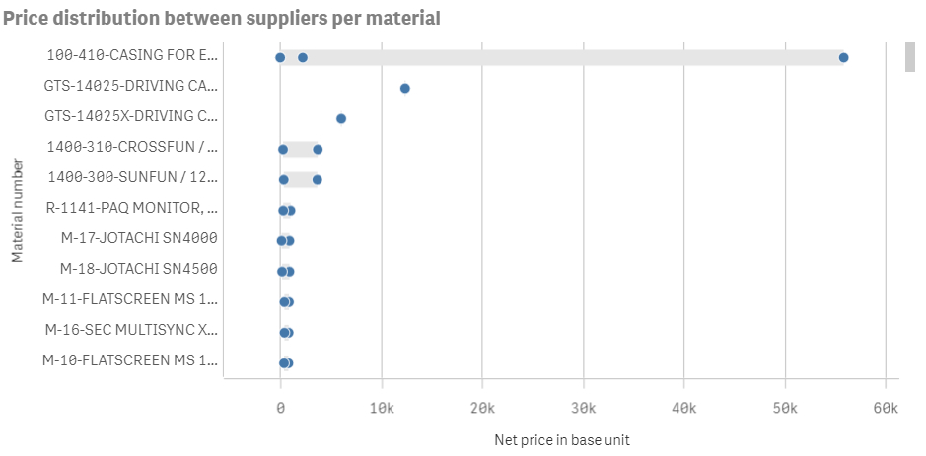
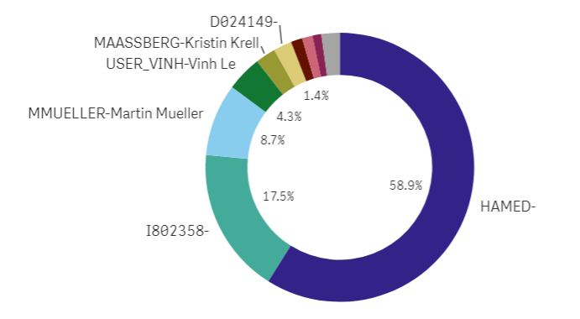
Report template
Observation
It was noted that 29.32M worth of POs have a purchase price that is >50% the average. A sample of 15 such POs was reviewed and it was found that the price had been inflated for all cases reviewed. Most of these cases were entered by user Hamed, who also has access to enter invoices and payments. The cases also mostly related to supplier Silicon Valley and material 100410 (casing).
Risk
Collusion with suppliers to raise prices in return for a kickback.
Inefficient purchasing process: failure to negotiate prices based on centralized pricing list.
Recommendation
Implement a centralized pricing guideline for purchasing and monitor purchase order pricing to ensure that it is in-line with this guidance. Encourage the purchasing team to benchmark prices against the pricing guideline. Ensure staff rotation within purchasing, to avoid collusion with third-parties.
Comments from the auditee
Agreed

